Slide 1
Cloud Computing Trend Report, 2017
Mobile, IoT and AI drive increased cloud adoption
David Vincent, Senior Analyst, Cloud Market Development, MD&I
Bill Chamberlin, Distinguished Market Intelligence Professional, MD&I HorizonWatch
February 15, 2017

Slide 2
About This Trend Report
Purpose: The slides provide an overview on the Cloud Computing trend
Content: Summary information about the Cloud Computing marketplace, including trends drivers, spending trends, industry business cases, and adoption challenges. Also included are links to additional resources.
How To Use This Report: This report is best read/studied and used as a learning document. You may want to view the slides in slideshow mode so you can easily follow the links
Available on Slideshare: This presentation (and other Trend Reports for 2017) will be available publically on Slideshare at http://www.slideshare.net/horizonwatching
Please Note: This report is based on internal IBM analysis and is not meant to be a statement of direction by IBM nor is IBM committing to any particular technology or solution.
15Feb2017
Cloud Computing Trend Report, 2017 (External Version)

Slide 3
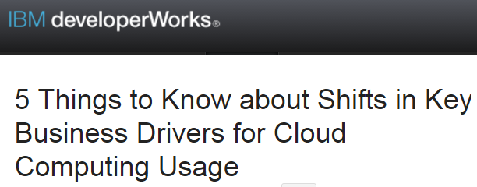
Cloud Computing – Trend Overview
Key Insights
Drivers
Clouds offer cost savings & an attractive pay-as-you-go model
Clouds can enable the speed of delivery of new services & capabilities, enabling rapid innovation
Hybrid cloud models allow organizations to move part of their data into the public cloud, while keeping other IT-resources on-site or in a private cloud
Mobile, IoT and AI use cases drive cloud adoption
Challenges
Security risks of public clouds continue to be a concern
Many enterprises don’t want their data stored by a third party or where other users potentially have access to their data
Many enterprises still don’t have cloud computing skills in house
Implications
Large enterprises are increasingly designing for hybrid clouds and are looking for hybrid development platforms
The demand for anytime, on-the-go accessibility will be a major force in the continued adoption of cloud computing
Expect continued development of delivery models (Iaas, PaaS, and Saas) as enterprises seek to build and deploy cloud applications
Startups, companies with complex supply chain operations and companies going through reorganizations or business process transformations are good candidates for clouds
IBM developerWorks: 5 Things to Know about Shifts in Key Business Drivers for Cloud Computing Usage
“The disruptive nature of cloud computing is continuing to challenge technology management, including I&O teams. The cloud market will accelerate even faster in 2017, as enterprises are leveraging cloud computing to power their core business systems and customer-facing applications” Forrester
“Cloud's impact is massive, and IDC predicts that the greater cloud spending (cloud services and IT products) will exceed $500 billion by 2020, driven by:
Growth in SaaS, PaaS & IaaS spending
5-10x growth in new apps and services, including IoT and cognitive solutions
Penetration of "cloud code" into on-premise software
Expansion of cloud managed and professional services” IDC
15Feb2017
Cloud Computing Trend Report, 2017 (External Version)

Slide 4
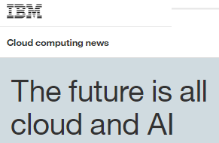
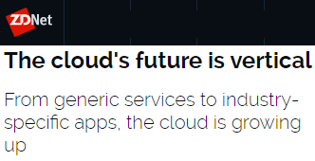
Trends to Watch in 2017
Market Trends
Convergence of IaaS and PaaS Cloud Services: The IaaS and PaaS cloud service models are converging to a single, unified model that combines these services as an integrated IaaS+PaaS offering which will disrupt existing markets. Enterprises will transform niche IaaS offerings into hybrid cloud managed hosting offerings that add value across the IaaS+PaaS spectrum. Technology strategists must understand the opportunities and threats from delivering and consuming cloud services through these historically distinct offerings.
AI and IoT use cases drive cloud adoption: Artificial intelligence in the cloud promises to be the next great disrupter as computing is evolving from a mobile-first to an artificial intelligence-first model. The proliferation of cloud-based Internet of Things (IoT) in the marketplace continues to drive cloud demand, as cloud allows for secure storage of massive amounts of structured and unstructured data central to IoT core function.
Industry Clouds will be one of the fastest growing segments: The industry cloud market is growing fast, with dozens emerging each month throughout many industries, including financial services, healthcare, life sciences, manufacturing, retail, energy and government. Industry clouds will create broad industry value by aggregating cost reduction, operational benefits, risk mitigation, and/or insight creation via pooled information.
“The accelerating convergence of IaaS and PaaS into a service model combining the two will disrupt existing markets.” Gartner: Market Trends: The Convergence of IaaS and PaaS Cloud Services
IBM: The future is all cloud and AI
ZDNet: The cloud's future is vertical
15Feb2017
Cloud Computing Trend Report, 2017 (External Version)

Slide 5
Trends to Watch in 2017 (continued)
Market Trends
Containers will alter cloud platform and management strategies: Linux containers, popularized by Docker, will be available in every major public and private cloud platform by early 2017. Developers will consume them directly to power microservices development. This will mean that organizations will be rethinking their PaaS, container orchestration and cloud management needs. The organizations will have to alter the cloud strategy to accelerate their path to more effective Devops.
Hybrid Cloud Services/Platforms. Hybrid cloud - and hybrid IT - is the end game for the majority of enterprises. Integration and management are complicated driving enterprises to seek help from service providers. Enterprises are also seeking platforms that can manage and deploy a consistent set of cloud services for use in both on-premises and off-premises clouds and improve interoperability and integration of data from different implementations.
Cloud hyperscale providers growth creates virtuous cycle: Hyperscale providers will continue to leverage scale-driven benefits (e.g., lower cost, large user base), to expand their geographic footprint, develop user-requested capabilities, attract partners, and command market attention, leading to a virtuous cycle. Growth allows / drives hyperscalers to expand beyond cloud into adjacent spaces like IoT, AI, analytics, and services, becoming ever more entrenched within their customer base and feeding the virtuous cycle.
“Container technology sits at the center of cloud-native applications and platforms and provides business and architectural benefits, such as improvement of DevOps-style software delivery to accelerate innovation, as well as performance advantages for infrastructure automation and efficiency”: Charlie Dai, Forrester Analyst
“Enterprises will demand that IT vendors craft a holistic platform to allocate workloads strategically to the best execution venue, and do so while managing business continuity across what has become a hybrid multi-cloud enterprise architecture.”: 451 Research
“As network upgrades continue to prop up cloud growth overall, the hyperscale cloud datacenters are coming and they will drive new server and storage deployments over the next few quarters.”: IDC
15Feb2017
Cloud Computing Trend Report, 2017 (External Version)

Slide 6
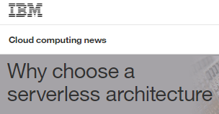
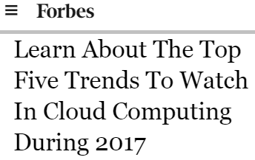
Emerging Trends to Watch in 2017
Market Trends
Workload acceleration: Cloud providers are increasingly adding “workload acceleration” hardware such as GPUs and FPGAs to their cloud infrastructure to provide higher performance and enable new features and workloads.
Serverless computing: Serverless computing, or Function as a Service (FaaS), is rapidly gaining traction as a means of consuming cloud services, especially for implementing microservices or creating simple, low-cost, trigger-based activities.
Trusted / hardened / shielded VMs: In cloud environments that permit multitenancy, workload isolation and security are paramount customer concerns. Major cloud providers are delivering solutions to securely isolate guest workloads from their host and each other.
Data center proliferation: Customer requirements for data sovereignty, regulatory compliance, and application latency demand clouds deployed on a global scale. Such deployments require a massive, ongoing investment of capital and resources.
Cloud-based management of on-premises and mobile assets: Global deployments, decentralized self-service IT, and mobile workforces are difficult to manage using on-premises consoles and related data stores. Cloud-based solutions enable asset management anywhere, from any device.
IBM: Why choose a serverless architecture
IBM: Learn About The Top Five Trends To Watch In Cloud Computing During 2017
15Feb2017
Cloud Computing Trend Report, 2017 (External Version)

Slide 7
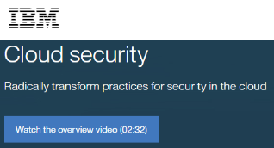
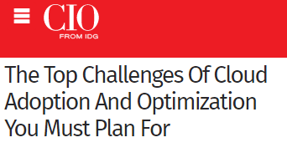
Security and other challenges continue to inhibit the adoption of cloud computing solutions and services
Adoption Challenges
Security. Enterprise cloud adoption requires a structured approach to security. Cloud computing is very different than physical or virtual servers, which translates into a different cybersecurity model as well. And these differences lead to a variety of security challenges.
Skills gaps remain. Integrating multi-cloud and hybrid IT environments can be a complex project, especially for small and medium businesses. Many firms desire in-house skills before investing in cloud solutions.
Data location and privacy are growing concerns. Where the data resides is important for many firms, especially when considering regulatory and compliance solutions.
Enterprises need better metering and usage tracking capabilities to understand ROI. Improved capability can help firms optimize existing cloud usage and provide them visibility into the real cost and ROI.
IT and LOB ownership issues. For some firms, IT and LOB cloud purchasing and ownership conflicts can slow down project timelines.
IBM: Cloud Security
“As enterprises continue to focus on implementing a cloud infrastructure, many still face roadblocks when it comes to hiring candidates with the right skills.” CIO
Information Age: The Top Challenges Of Cloud Adoption And Optimization You Must Plan For
15Feb2017
Cloud Computing Trend Report, 2017 (External Version)

Slide 8
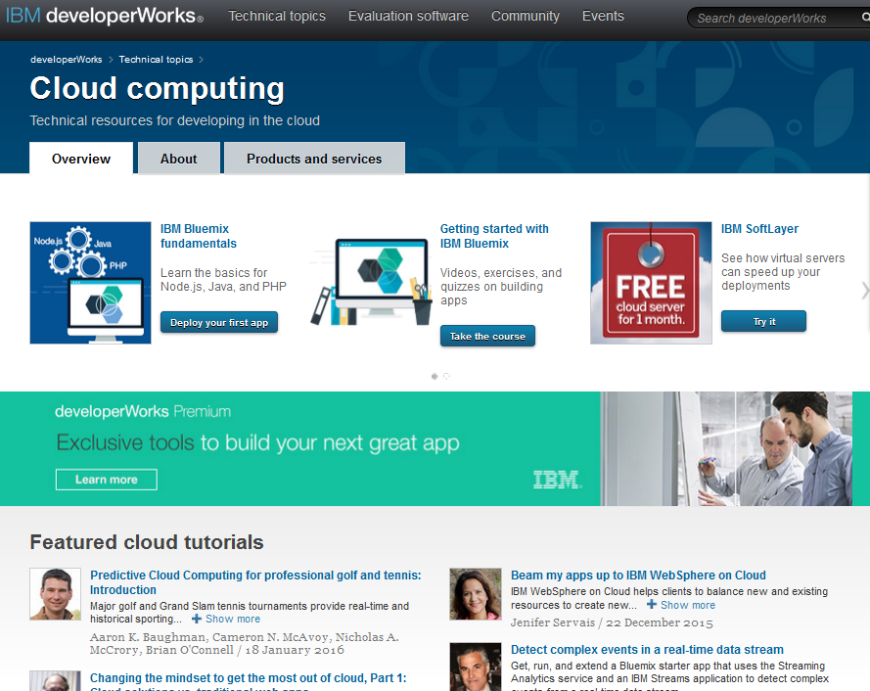
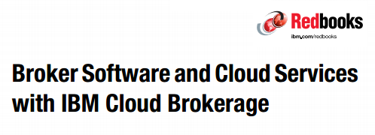
Selected IBM Resources and Links
Featured Links
ibm.com links
IBM Cloud IBM’s cloud computing portal
  Marketplace
  Solutions
  Bluemix
  Softlayer
  DevOps Services
  Hybrid Integration
  Cloud Managed Services
DeveloperWorks Cloud portal for developers
  Learn about Cloud Computing
  IBM Tools / Code
Partnerworld Cloud Computing portal for Partners
IBM Redbooks: Cloud
DeveloperWorks Cloud portal for developers
IBM: Broker Software and Cloud Services
with IBM Cloud Brokerage
15Feb2017
Cloud Computing Trend Report, 2017 (External Version)
Notes:
This page provides you with some links to information and resources regarding this trend. The blue text is hotlinked, so just right click and then “open Hyperlink” go to the website.

Slide 9
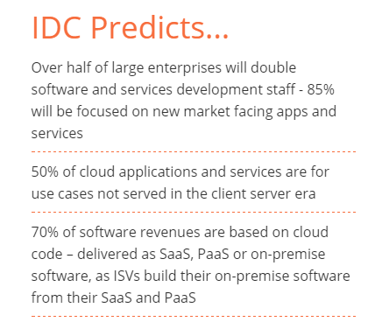
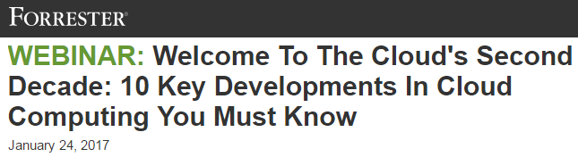
Selected Analyst Websites and Resources
Featured Links
451Research: Cloud
TBR Research: Cloud
Forrester: Cloud Computing and Cloud Blog Posts
Frost & Sullivan: Search for Cloud Computing
Gartner: Research and Blogs
GigaOM: Cloud
IDC: Cloud Computing
Synergy: Press and Research
IDC: Cloud Computing
Forrester: Webinar
“Public cloud services are the biggest disruption in the tech market in the past 15 years — and adoption is accelerating.” Forrester
15Feb2017
Cloud Computing Trend Report, 2017 (External Version)
Notes:
This page provides you with a list of Additional Information and Resources. The blue text is hotlinked, so just right click and then “open Hyperlink” go to the website.

Slide 10
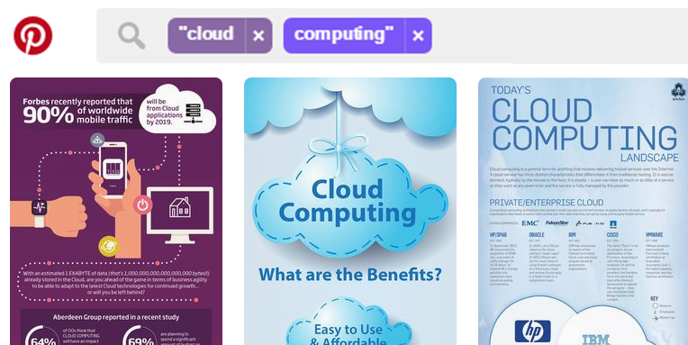
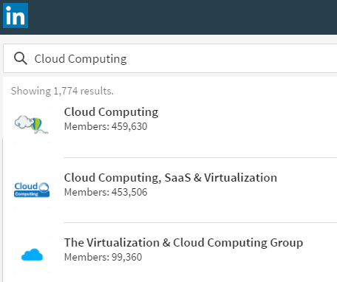
Selected Social Media Websites & Searches
Featured Links
Google Search: Cloud Computing
LinkedIn Group Search: Cloud Computing
Pinterest Search: Cloud Computing
Slideshare search: Cloud Computing
Twitter hashtags: #cloud / #cloudcomputing / #cloudchat
Tumblr Search: Cloud Computing
YouTube: Cloud Computing Playlists and Cloud Computing Channels
Pinterest Search: Cloud Computing
LinkedIn Group Search: Cloud Computing
15Feb2017
Cloud Computing Trend Report, 2017 (External Version)
Notes:
This page provides you with a list of Additional Information and Resources. The blue text is hotlinked, so just right click and then “open Hyperlink” go to the website.

Slide 11
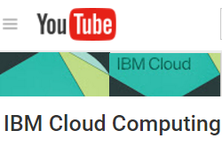
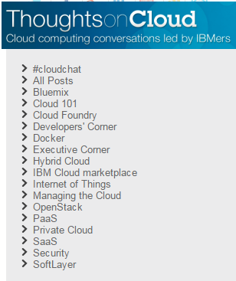
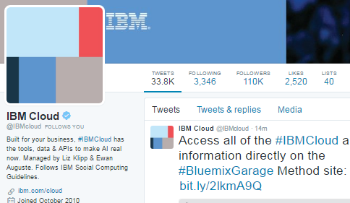
Selected IBM Social Media Channels
Featured Links
IBM Social Media Sites and Accounts
Thought Leadership Blog: Thoughts on Cloud
DeveloperWorks: Blogs tagged cloud
Twitter IBMCloud / Hashtags: #ibmcloud / #smartcloud
Facebook Page: IBM Cloud
Instagram: Posts tagged #ibmcloud
YouTube: IBM Cloud
Google+ page: IBM Cloud Computing
LinkedIn Group: IBM Cloud Computing
Developerworks: Connect and Collaborate on Cloud Topic
Youtube: IBM Channel
Thoughts on Cloud (Blog)
Twitter IBMCloud
15Feb2017
Cloud Computing Trend Report, 2017 (External Version)
Notes:
This page provides you with some links to information and resources regarding this trend. The blue text is hotlinked, so just right click and then “open Hyperlink” go to the website.

Slide 12
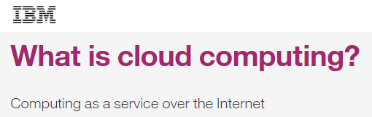
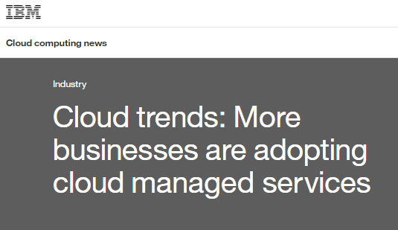
Other Selected Reports and Resources
Featured Links
451 Research: 2017 Trends in Cloud Transformation (Exec Summary)
Bloomberg: 5 trends for cloud computing and the data center in 2017
CIO Today: Infrastructure-as-a-Service Predictions for 2017
Cloud Academy: 2017 Trends in Cloud Computing: Cloud is the new normal
CloudTweaks: 2017 will be the year we adopt the AI-Focused Cloud
IBM: Cloud trends: More businesses are adopting cloud managed services
Information Week: 2017 State of the Cloud Report
InfoWorld: 3 reasons why 2017 will see massive cloud migration
Network World: Trends in Enterprise Cloud Adoption
Silicon: Four Cloud Computing Trends To Expect In 2017
IBM
IBM
15Feb2017
Cloud Computing Trend Report, 2017 (External Version)
Notes:
This page provides you with some links to information and resources regarding this trend. The blue text is hotlinked, so just right click and then “open Hyperlink” go to the website.

Slide 13
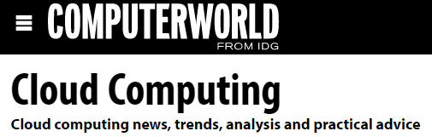
Selected Media Websites & Resources
Featured Links
CIO.com: Cloud Computing
ComputerWorld: Cloud Computing
eWeek: Cloud
Forbes: Cloud Computing
How Stuff Works: Cloud Computing
InformationWeek: Cloud / SaaS / PaaS / IaaS
InfoWorld: Cloud portal
Network Computing: Cloud
Network World: Cloud Computing
Wikipedia: Cloud Computing / Platform as a service / Software as a service / Network as a Service / Cloud Storage / Fog Computing
ComputerWorld: Cloud Computing
15Feb2017
Cloud Computing Trend Report, 2017 (External Version)
Notes:
This page provides you with a list of Additional Information and Resources. The blue text is hotlinked, so just right click and then “open Hyperlink” go to the website.

Slide 14
More Insights on Technology Trends are Available
Featured Links
Other slide decks in this Trend Report series have been posted to Slideshare
You are also invited to check out the following IBM websites and resources
  IBM Academy of Technology
  IBM Institute for Business Value
  IBM Research and Research News and 5 in 5
  IBM’s THINK blog
  IBM Think Academy on YouTube
15Feb2017
Cloud Computing Trend Report, 2017 (External Version)

