Slide 1
Internet of Things Trend Report, 2017
Reinventing processes, enabling new offerings, and changing how businesses engage with customers
Kimberly Hardin - Market Development Advisor, IoT, MD&I
Bill Chamberlin, Distinguished Market Intelligence Professional, MD&I HorizonWatch
February 18, 2017

Slide 2
About This Trend Report
Purpose: The slides provide an overview on the Internet of Things (IoT) trend
Content: Summary information about IoT marketplace insights, including trends drivers, spending trends, industry business cases, and adoption challenges. Also included are links to additional resources.
How To Use This Report: This report is best read/studied and used as a learning document. You may want to view the slides in slideshow mode so you can easily follow the links
Available on Slideshare: This presentation (and other Trend Reports for 2017) will be available publically on Slideshare at http://www.slideshare.net/horizonwatching
Please Note: This report is based on internal IBM analysis and is not meant to be a statement of direction by IBM nor is IBM committing to any particular technology or solution.
15Feb2017
Internet of Things Trend Report, 2017 (External Version)

Slide 3
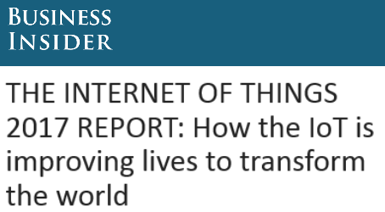
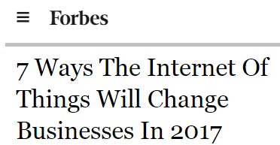
IoT can reinvent processes, enable new offerings, and change how businesses engage with customers
Key Insights
IoT’s integration with business is key. How well vendors integrate platform capabilities to achieve buyers most desired business outcomes is the most important factor in choosing an IoT platform vendor. Expect vendor messaging to align around achieving outcomes.
Software and Services enable transformation. As the battle for scale commoditizes IoT platforms, vendors differentiate through analytics and services that provide insights into buyers’ business problems. Expect mergers and acquisitions to fill in vendors’ spectrums of end-to-end horizontal and industry specific IoT solutions.
A nascent market matures into adolescence. IoT buyers report a healthy progression of IoT deployments over the past year. The momentum of multiple IoT related markets, solutions, industries maturing drives additional growth in IoT spending. Expect adoption of new technologies like cognitive and blockchain within IoT use cases.
Business Insider The Internet of Things 2017 Report
Forbes: 7 Ways The Internet Of Things Will Change Businesses In 2017
“The Internet of Things will be one of the primary drivers of the digital transformation that enterprises will undergo in the coming years, creating a self-learning environment that will drive digital disruption in physical world.” IBM: Top five Internet of Things trends for 2017
15Feb2017
Internet of Things Trend Report, 2017 (External Version)

Slide 4
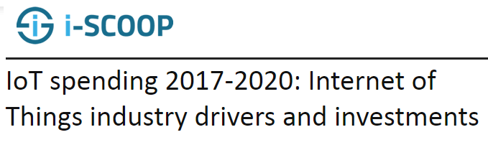
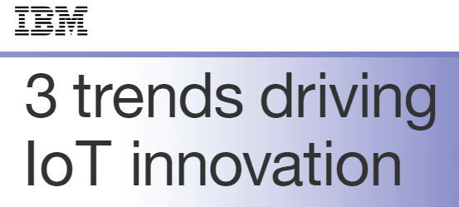
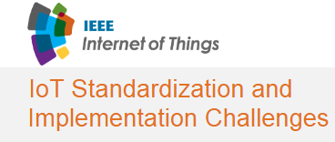
Internet of Things – enablers and challenges
Key Insights
Enablers
Expected business outcomes drive IoT investments. C-Level business and IT executives see IoT as strategic and are willing to invest
Proliferation of low cost of sensors and chips
Cloud-based mobile architectures and development capabilities
Edge analytics can lower the barrier to entry for enterprises who want to build IoT applications that don't require the more costly centralized or cloud processing and storage
Challenges
Security and privacy concerns
Integration with business
Measurable results
Change management issues
IoT analytics and security skills
Lack of technology standards
Upfront and ongoing costs
Data regulations
Network coverage, quality, and speed
i-SCOOP IoT spending 2017-2020: Internet of Things industry drivers and investments
IBM 3 trends driving IoT innovation
IEEE: IoT Standardization and Implementation Challenges
15Feb2017
Internet of Things Trend Report, 2017 (External Version)

Slide 5
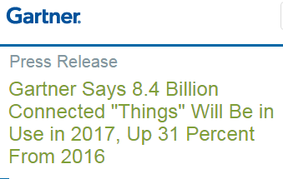
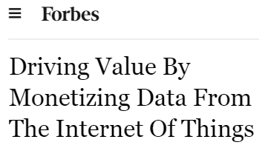
IoT represents enormous scale and impact
Key Insights
Connected devices are growing at an exponential rate: There number devices, sensors, and chips embedded into physical objects that have the ability to compute, connect to networks, and communicate data is exploding
Data will transform industries and professions: The ability to capture, integrate, analyze and then monetize data as an asset is in its early stages and will result in being a key competitive differentiator in the coming years.
Value derived from this connectivity drives massive monetary opportunity: As IoT networks get deployed across the entire economy the potential value lies in connecting the millions and billions of things, people and businesses in new ways the we can not fully imagine today.
Gartner Press Release
Forbes Driving Value By Monetizing Data From The Internet Of Things
“If policy makers and businesses get it right, linking the physical and digital worlds could generate up to $11.1 trillion a year in economic value by 2025.”. McKinsey Global Institute: Unlocking the potential of the Internet of Things
15Feb2017
Internet of Things Trend Report, 2017 (External Version)

Slide 6
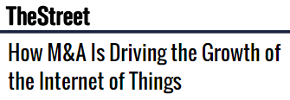
Internet of Things Trends to Watch in 2017
Market Trends
Partnerships. Cloud, software, services, and industrial vendors join to fill gaps in portfolios as not one vendor can do it all in IoT
Security. Analysts expect to see more, larger IoT-based attacks than what we experienced in 2016
Analytics and applications. Vendors build out horizontal and industry specific applications to provide end to end capabilities to customers
Cognitive use cases. The use of AI in IoT is gaining traction to help translate data into consumable and actionable insights for end users.
Hybrid IoT approach. Solutions that incorporate edge data and cloud analytics become customers’ top choice
The Street How M&A Is Driving the Growth in the Internet of Things
“Data, and more importantly analytics, are changing the way we see our machines, our processes and our operations. Analytics can identify patterns in the data, model behaviors of equipment, and predict failures based on a variety of variables that exist in manufacturing”. IBM via Forbes How Cognitive Computing And The IoT Can Transform Manufacturing To Please Customers
“We forecast there will be $4.8 trillion in aggregate IoT investment between 2016 and 2021.” Business Insider The Internet of Things 2017 Report
15Feb2017
Internet of Things Trend Report, 2017 (External Version)

Slide 7
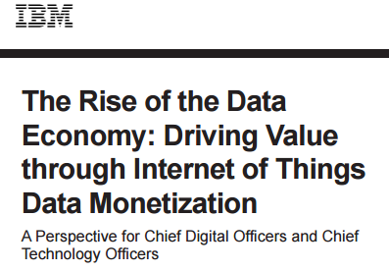
Internet of Things Trends to Watch in 2017
Market Trends
Tempered adoption expectations. Leaders realize complexity in IoT implementations and industry use cases mature at different rates
Proof of concept approach remains. IoT POCs are common and provide a stepwise approach to business transformation
Small IoT deployments expand. Enterprise wide deployments increase, supporting transformative efforts, as ROI from small projects is realized
IoT Blockchain pilots. Blockchain in IoT helps safeguard IoT transactions and allows autonomous things to function without centralized authority
Consumer IoT. Consumer device and messaging layers influence enterprise consumption of IoT data
IBM: The Rise of the DataEconomy: Driving Value through Internet of Things Data Monetization
“Blockchain is beginning to play a major part in the Internet of Things by enhancing security, enabling inclusion of low-value devices to be increasingly viable and making managing a device easier for decades to come.” IBM: What blockchain means for you, and the Internet of Things
15Feb2017
Internet of Things Trend Report, 2017 (External Version)

Slide 8
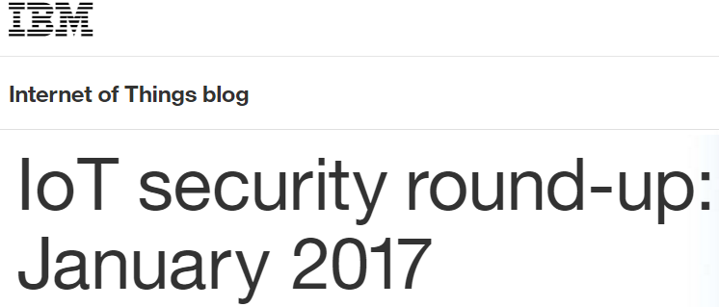
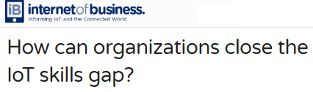
Challenges remain, inhibiting the maturation and scale of IoT in the short to medium term
Adoption Challenges
Security. If the IoT is to realize its full potential, security professionals must secure both IoT systems and the data collected
Hype and confusion. Skepticism due to overall media & vendor hype continues as well as confusion over the increasingly number of platforms, protocols and large sets of APIs
Lack of technology and data standards IT solutions are currently being assembled from a number of different technologies by a number of different vendors, setting up the possibility of device/sensor, infrastructure as well as data format incompatibilities.
Lack of understanding or clearly defined business cases. Enterprises want to see a clear path to a return on their investments on IoT, before investing.
Processes, skills and tools. The IoT is not all about new emerging technologies. Enterprises will need to transform processes and invest in new skills & tools.
IBM: IoT security round-up: January 2017
“Top IoT challenges include security (26%), privacy (21%), upfront cost (22%), on-going cost (19%), IT infrastructure (16%) and IoT skills (14%).” Forbes: Internet Of Things By The Numbers: IDC Survey Finds It's All About The Data
Internet of Business: How can organizations close the IoT skills gap?
15Feb2017
Internet of Things Trend Report, 2017 (External Version)

Slide 9
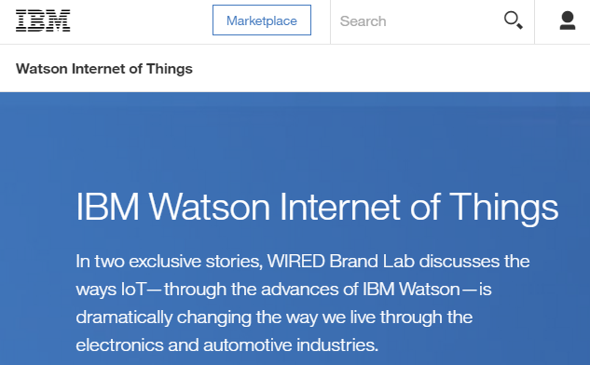

Selected IBM Resources and Links
Important Links
Primary Website: Watson and the Internet of Things
  What is the IoT?
  Watson IoT Platform
  Connected Manufacturing
  Developer Resources
  IoT News
  IBM’s IoT Blog
  IBM IoT Events and Webinars
IBM Events: Watson Internet of Things
IBM Cloud Bluemix: Internet of Things
IBM DeveloperWorks: Internet of Things
IBM: Watson IoT Academy
IBM Institute for Business Value: The Business of Things
Website: Watson and the Internet of Things
IBM: Watson IoT Academy
15Feb2017
Internet of Things Trend Report, 2017 (External Version)
Notes:
This page provides you with some links to information and resources regarding this trend. The blue text is hotlinked, so just right click and then “open Hyperlink” go to the website.

Slide 10
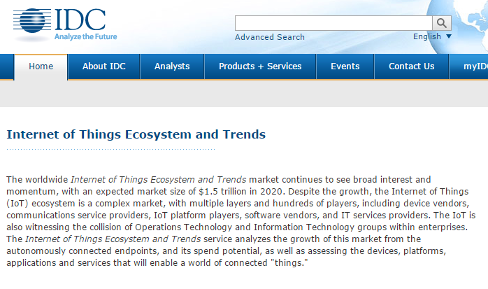
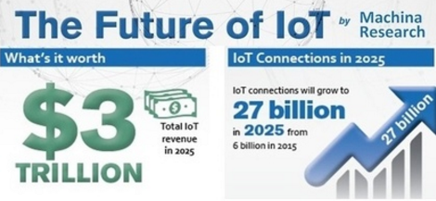
Selected Analyst Websites and Resources
Important Links
451 Research: Internet of Things
ABI Research: Internet of Things
Beecham Research: M2M/IoT Sector Map, IoT Security Threat Map
Forrester: IoT Reports
Frost & Sullivan: Internet of Things
Gartner: Internet of Things
Harbor Research: IoT
IDC: Internet of Things Ecosystem and Trends / search: Internet of Things
Internet of Council and Internet of People
Machina Research: website
TBR Research: Internet of Things
IDC: Internet of Things Ecosystem and Trends
Machina Research: website
15Feb2017
Internet of Things Trend Report, 2017 (External Version)
Notes:
This page provides you with some links to additional information and resources regarding this trend. The blue text is hotlinked, so just right click and then “open Hyperlink” go to the website.

Slide 11
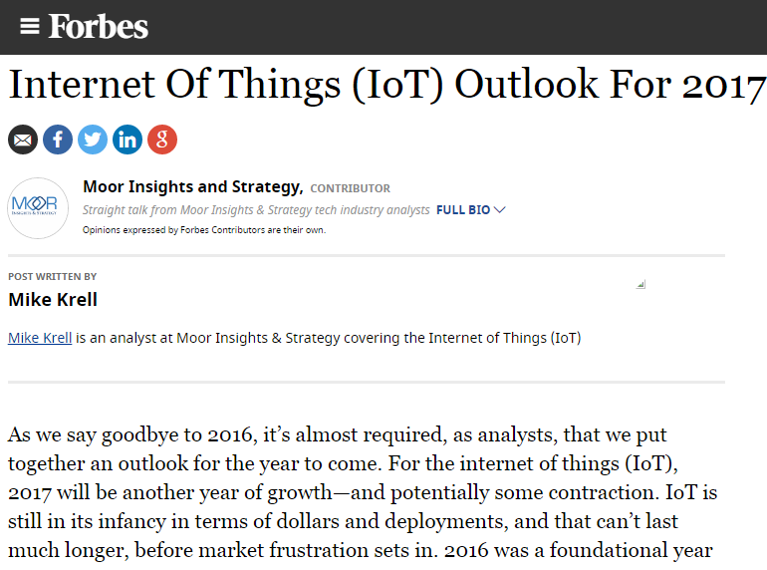
Selected Media Websites and Resources
Important Links
CIO.com: Internet of Things
ComputerWorld: Internet of Things
GigaOM: Internet of Things
Forbes: Internet of Things, M2M
InformationWeek: Internet of Things, M2M
InfoWorld: Internet of Things, M2M
IoT Council
MIT Technology Review: Internet of Things
Venture Beat: Internet of Things, M2M
Wired.com: Internet of Things
ZDNet: Internet of Things
Forbes: Internet Of Things (IoT) Outlook For 2017
“The goal of any sensor is pretty simple: gather information(vibration, temperature, pressure, voltage) that can be fed into algorithms and analytics for better real-time decision-making. The more data the sensors gather, the better the real-time analysis of that info.” Wired
15Feb2017
Internet of Things Trend Report, 2017 (External Version)
Notes:
This page provides you with some links to additional information and resources regarding this trend. The blue text is hotlinked, so just right click and then “open Hyperlink” go to the website.

Slide 12
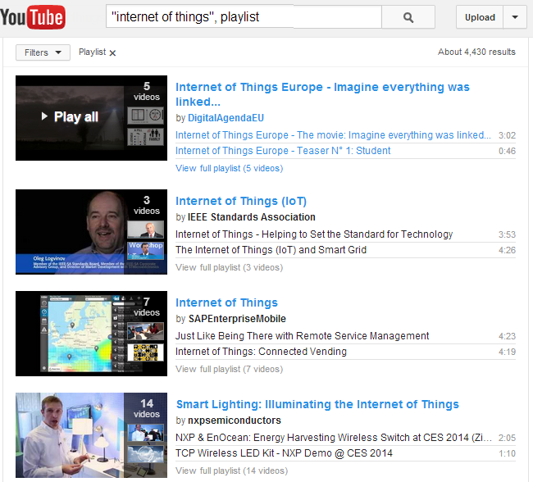
Selected Social Media Sites and Searches
Important Links
LinkedIn Group Search: Internet of Things
Pinterest Search: Internet of Things, Machine to Machine
Slideshare search: Internet of Things
Twitter search Popular hashtags = #IoT / #Sensors / #M2M
Tumblr Search: Internet of Things and IoT
YouTube: Internet of Things Playlists and Internet of Things Channel
Wikipedia: Internet of Things, M2M
Internet of Things Playlists on YouTube
15Feb2017
Internet of Things Trend Report, 2017 (External Version)
Notes:
This page provides you with some links to additional information and resources regarding this trend. The blue text is hotlinked, so just right click and then “open Hyperlink” go to the website..

Slide 13
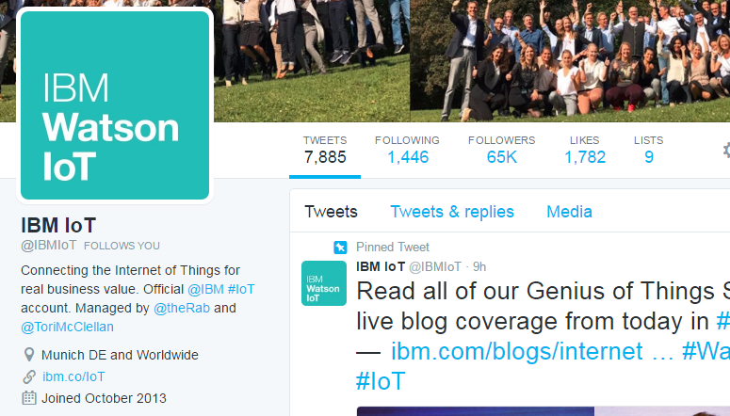
Selected IBM venues on Social Media
Important Links
Example posts on the IBM IoT Blog
Watson IoT Headquarters in Munich: A hive for innovation
IoT security: What are the keys to protecting the castle 24×7?
The Watson IoT Global Headquarters is open
Blockchain means big changes for IoT: Are you ready?
A framework for Industry 4.0
IBM: IoT Blog
Facebook: IBM IoT
Twitter: IBMIoT
LinkedIn: IBM Internet of Things
Google+: IBM Internet of Things
IBM Center for Applied Insights blog: Posts tagged IoT
DeveloperWorks Community: IoT Foundation / Blog Search: Internet of Things
Big Data & Analytics Hub: Internet of Things blogs
Twitter: IBMIoT
15Feb2017
Internet of Things Trend Report, 2017 (External Version)
Notes:
This page provides you with some links to additional IBM specific information and resources regarding this trend. I have provided for you links to IBM Social Media accounts related to this trend. The blue text is hotlinked, so just right click and then “open Hyperlink” go to the website.

Slide 14
More Insights on Technology Trends are Available
Important Links
Other slide decks in this Trend Report series have been posted to Slideshare
You are also invited to check out the following IBM websites and resources
  IBM Academy of Technology
  IBM Institute for Business Value
  IBM Research and Research News and 5 in 5
  IBM’s THINK blog
  IBM Think Academy on YouTube
15Feb2017
Internet of Things Trend Report, 2017 (External Version)

